Slide 1

An Organization Tool
180041208
Fida Kamal
180041223
Shah Jawad Islam
180041229
Alvi Aveen Khan
Presentation on
UI Mock-ups
CSE 4510: Software Development

Slide 2
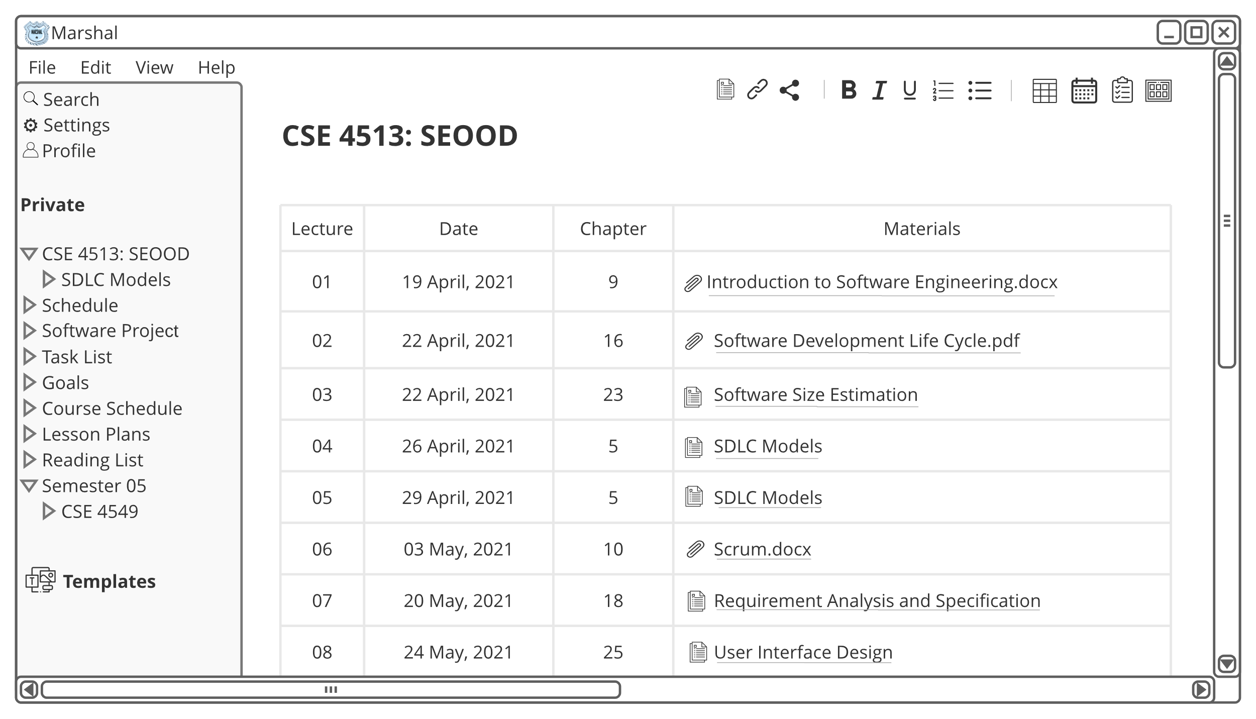

Slide 3
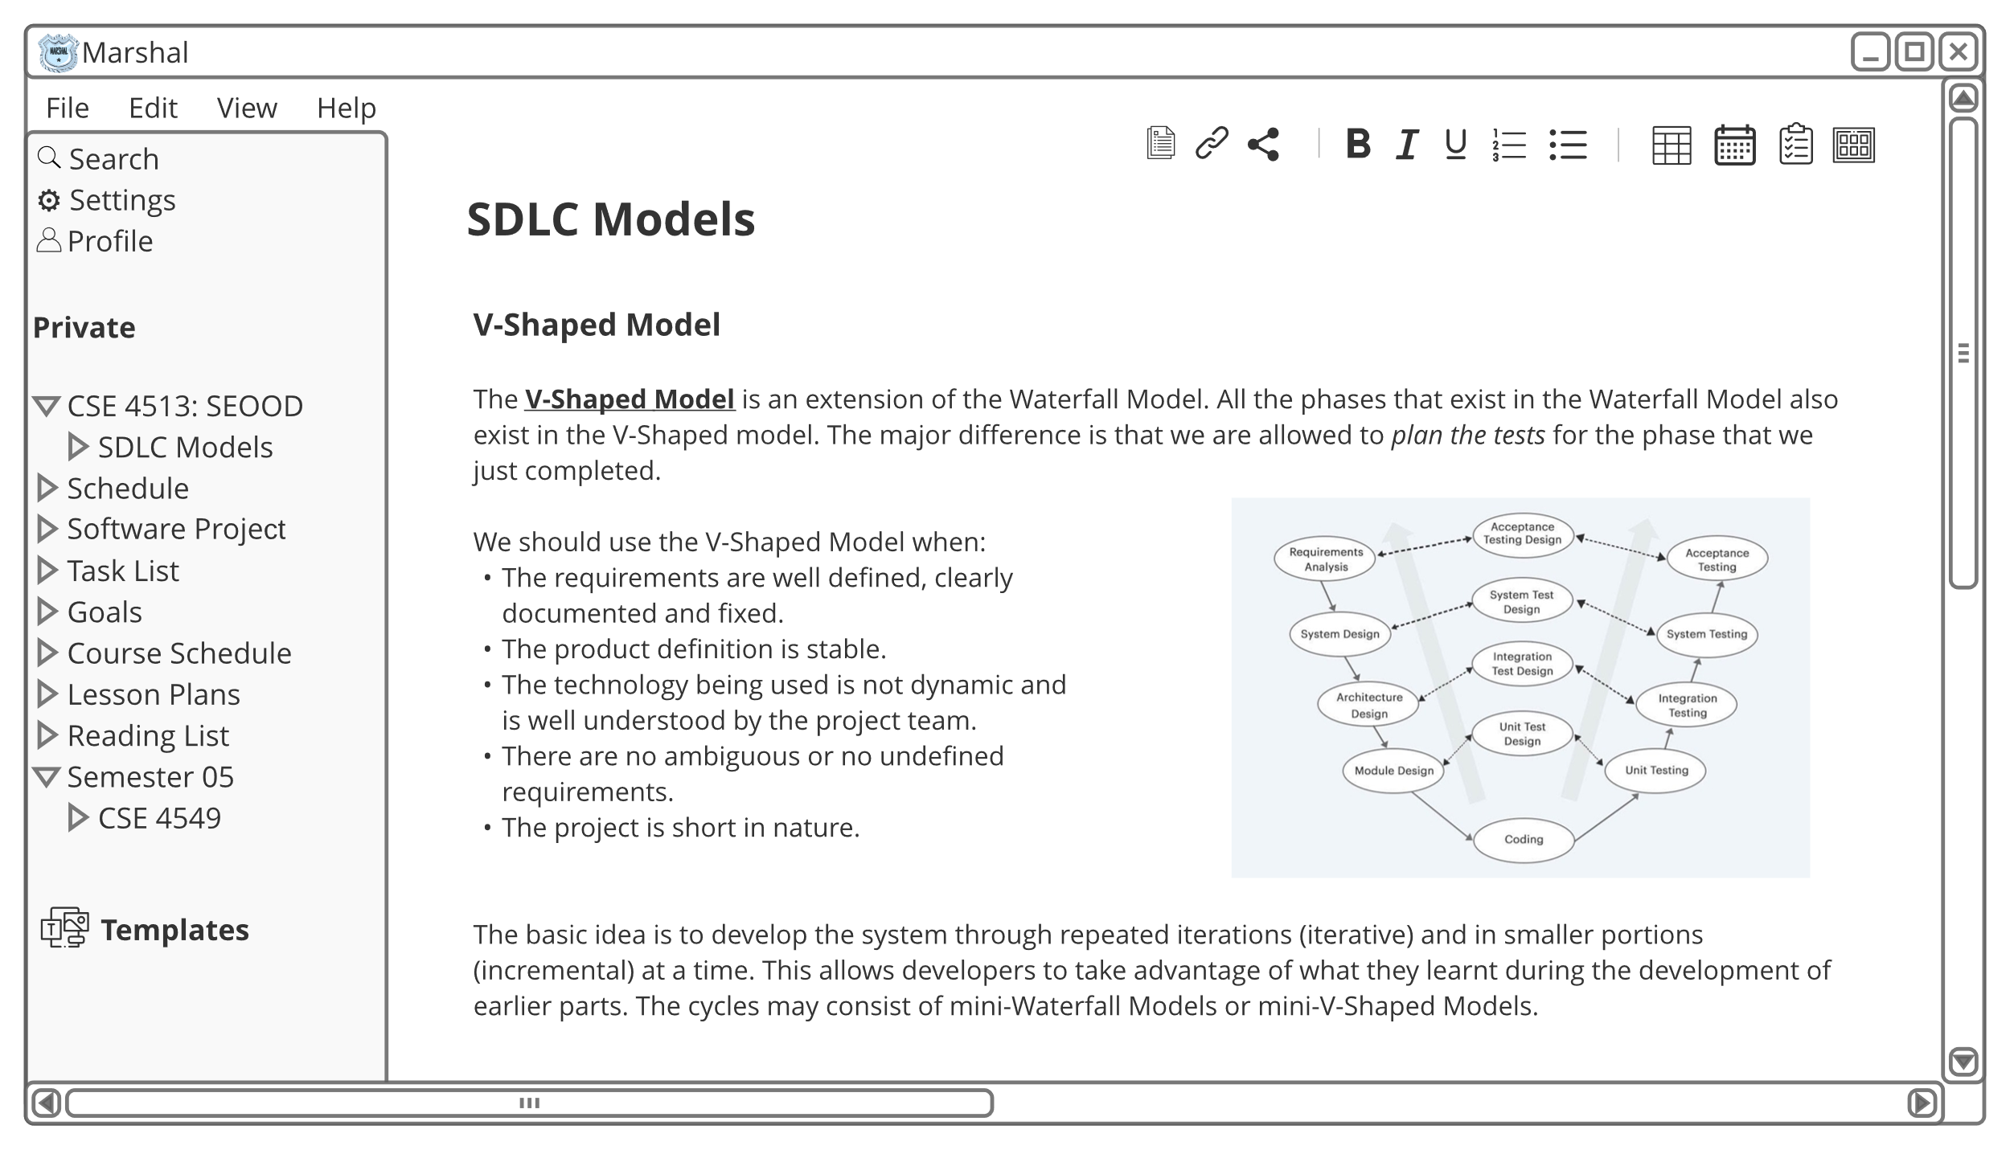

Slide 4
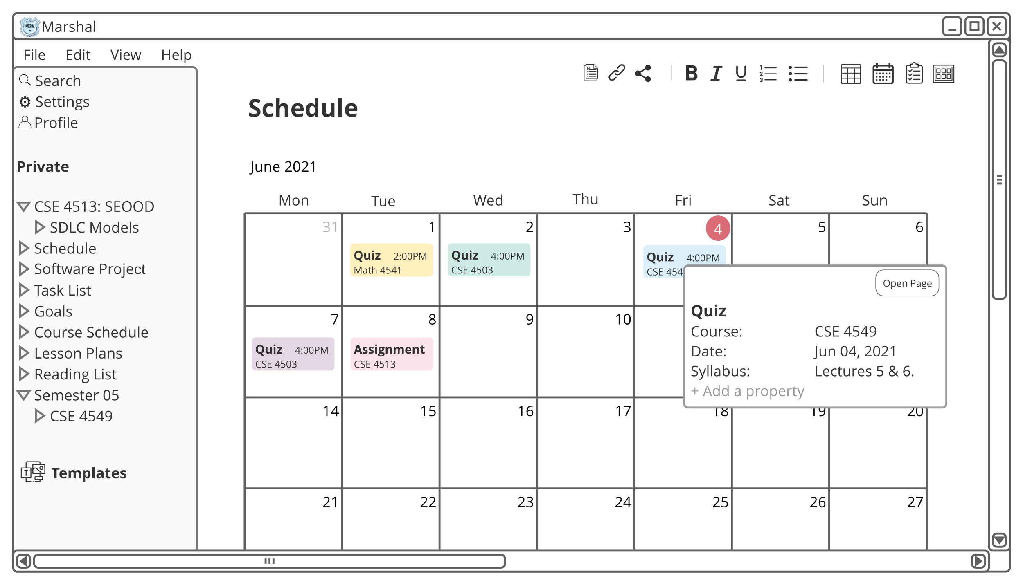

Slide 5
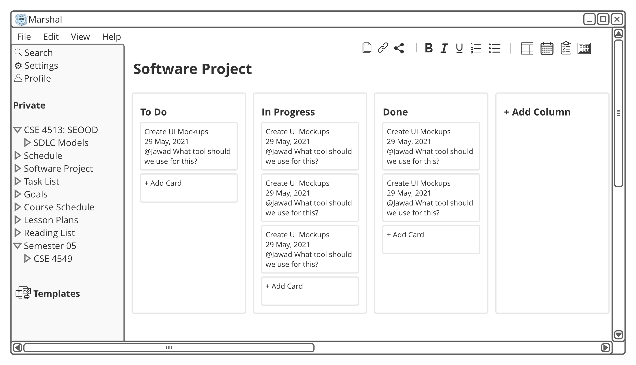

Slide 6
Thank you

